Slide 1
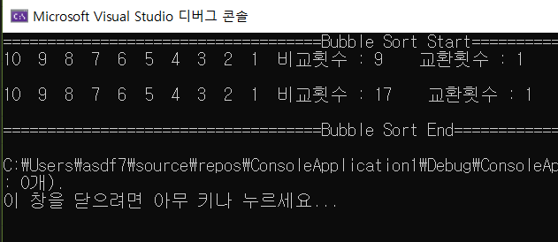
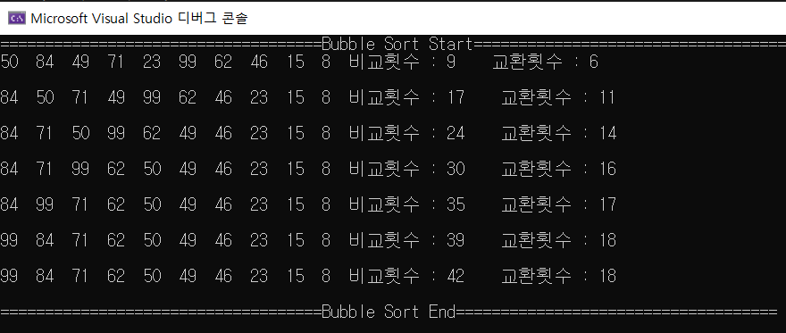
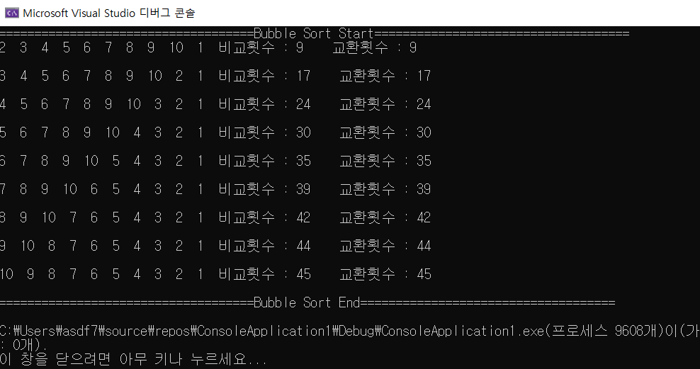
Bubble Sort
소스 코드 | 실행 화면
#include <iostream> #include <string> using namespace std; int Bubble(int arr[10], int n) { int a = 0, b = 0, c = 0; int temp; int cnt1 = 0, cnt2 = 0; bool flag = false; for (a = 0; a < n - 1; a++) { flag = true; for (b = 0; b < n - 1 - a; b++) { if (arr[b] < arr[b + 1]) { temp = arr[b]; arr[b] = arr[b + 1]; arr[b + 1] = temp; cnt2++; flag = false; } cnt1++; } for (c = 0; c < n; c++) cout << arr[c] << " "; cout << "비교횟수 : " << cnt1; cout << " 교환횟수 : " << cnt2 << "\n" << endl; if (flag) return 1; } } int main() { //int arr[10] = {50,23,84,49,71,15,99,62,46,8}; //int arr[10] = { 1,2,3,4,5,6,7,8,9,10 }; int arr[10] = { 10,9,8,7,6,5,4,3,1,2 }; cout << "====================================Bubble Sort Start====================================" << endl; Bubble(arr, 10); cout << "====================================Bubble Sort End====================================" << endl; }
소프트웨어 공학과 주간1C 2학년201804000 김성진

Slide 2
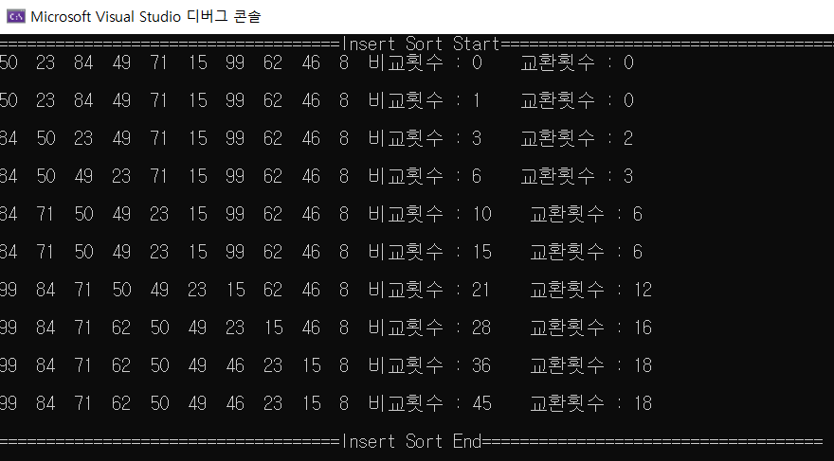
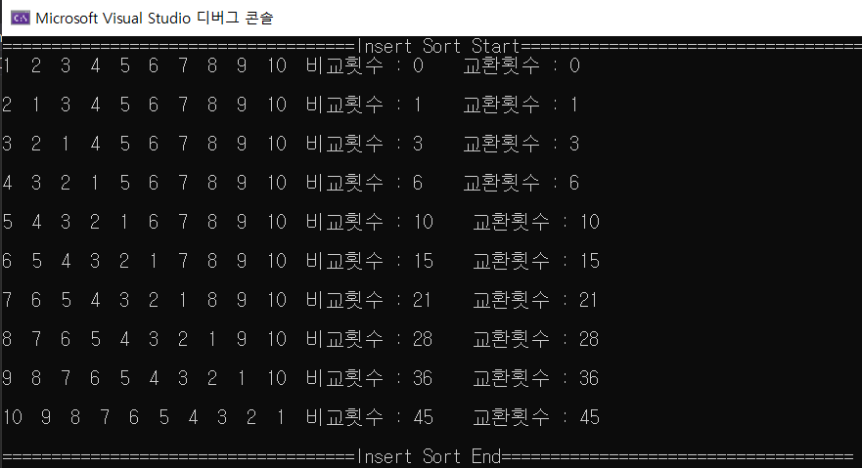
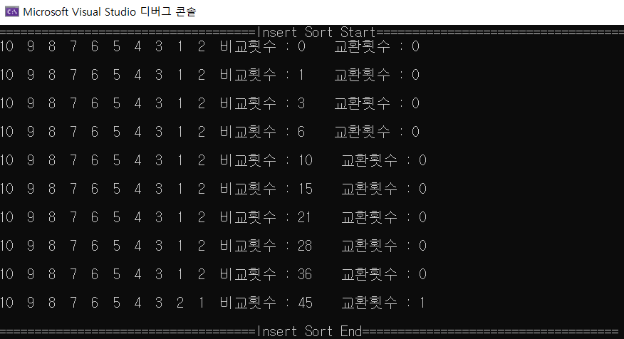
Insert Sort
소스 코드 | 실행 화면
#include <iostream> #include <string> using namespace std; void Insert(int arr[10], int n) { int a = 0, b = 0, c = 0; int temp; int cnt1 = 0, cnt2 = 0; for (a = 0; a < n; a++) { for (b = a; b > 0; b--) { if (arr[b - 1] < arr[b]) { temp = arr[b]; arr[b] = arr[b - 1]; arr[b - 1] = temp; cnt2++; } cnt1++; } for (c = 0; c < n; c++) cout << arr[c] << " "; cout << "비교횟수 : " << cnt1; cout << " 교환횟수 : " << cnt2 << "\n" << endl; } } int main() { int arr[10] = {50,23,84,49,71,15,99,62,46,8}; //int arr[10] = { 1,2,3,4,5,6,7,8,9,10 }; //int arr[10] = { 10,9,8,7,6,5,4,3,1,2 }; cout << "====================================Insert Sort Start====================================" << endl; Insert(arr, 10); cout << "====================================Insert Sort End====================================" << endl; }
소프트웨어 공학과 주간1C 2학년201804000 김성진

Slide 3
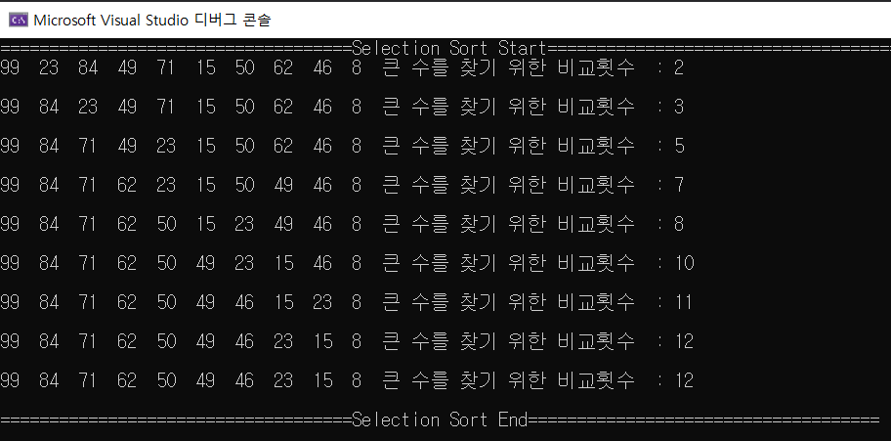
Selection Sort
소스 코드 | 실행 화면
#include <iostream> #include <string> using namespace std; void Selection(int arr[10], int n) { int a = 0, b = 0, c = 0; int temp = 0, index = 0; int cnt1 = 0; for (a = 0; a < n - 1; a++) { index = a; for (b = a; b < n; b++) { if (arr[index] < arr[b])//새로운 큰 수 찾기 { index = b; cnt1++; } } temp = arr[a]; arr[a] = arr[index]; arr[index] = temp; for (c = 0; c < n; c++) cout << arr[c] << " "; cout << "큰 수를 찾기 위한 비교횟수 : " << cnt1; cout << "\n" << endl; } } int main() { int arr[10] = { 50,23,84,49,71,15,99,62,46,8 }; cout << "====================================Selection Sort Start====================================" << endl; Selection(arr, 10); cout << "====================================Selection Sort End====================================" << endl; }
소프트웨어 공학과 주간1C 2학년201804000 김성진

